Slide 1

NOAA-HPC GT4Py Workshop
Start time: 1:30 EST
Content:
Presenter:
Infrastructure and Halo Updates
Jeremy McGibbon

Slide 2
Motivation
So you’ve learned everything about GT4py.
You want to build a dynamical core.
What’s missing?
(voice or type in Slack)

Slide 3
Motivation
So you’ve learned everything about GT4py.
You want to build a dynamical core.
What’s missing?
Domain decomposition
Metadata
Halo updates

Slide 4
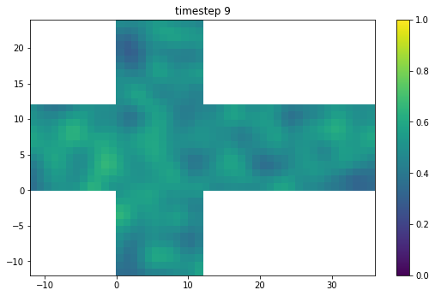
What to expect in this session
Start with motivation
Material:
Partitioning the cube
Quantity
Halo updates
End goal: run a gt4py stencil in parallel on the cubed sphere
Notes:
4

Slide 5
Motivation
FMS: To wrap or not to wrap
FMS already provides performant halo updates, could be wrapped
Would be an unknown challenge to get FMS to work with GPU data
Easier to modify code in a high-level dynamic language
Notes:
5

Slide 6
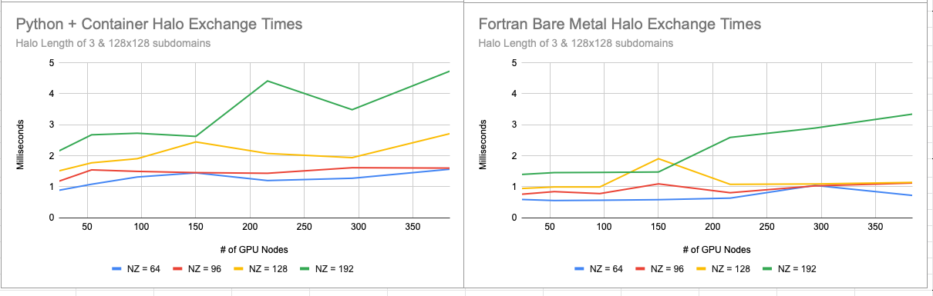
Motivation
FMS Performance Comparison
FMS more performant, but both scale well
# of nodes
# of nodes
Notes:
6

Slide 7
Motivation
What is fv3gfs-util?
Used by dynamical core and by fv3gfs-wrapper (workshop in Jan)
Must support both “model” code like dynamics and high-level analysis code
FMS is a framework, fv3gfs-util is a toolkit
Notes:
7

Slide 8
cube.halo_update(quantity, n_points=3)
Notes:
8

Slide 9
Learning goals for this session
Understand how data is partitioned between processes on the FV3 cubed sphere
Know what a 3D numpy array represents as part of a cubed sphere
Track halo and non-halo data using Quantity
Perform a halo update on the cubed sphere using MPI
Notes:
9

Slide 10
The FV3 Cubed Sphere
Learning Goal*:
How is data partitioned between processes on the FV3 cubed sphere?
How much of the globe is on one process?
* this review will motivate the existence of code objects

Slide 11
The FV3 Cubed Sphere
Dynamics
Shallow water (2D) advection in the horizontal
Lagrangian advection in the vertical
i.e. thickness of shallow layers changes
Periodic remapping in the vertical
Notes:
11

Slide 12
The FV3 Cubed Sphere
Horizontal Grid
Maps a cube to a sphere
Much easier to partition a cube
Take a cube, and “inflate” it outward to the planetary surface
Figure 5 from Washington et al. 2008
Notes:
12

Slide 13
The FV3 Cubed Sphere
Partitioning
Each tile face is separated into processes (ranks) according to the same “layout” (nx, ny)
e.g. a (2, 2) layout has 4 processes on each tile, and 24 processes in total
Notes:
13

Slide 14
The FV3 Cubed Sphere
Partitioning
Given a rank and a direction, tell me:
What rank is over there?
What is the relative rotation of the two ranks?
Complex responsibility!
Needs its own encapsulation
Add shading by rank
Notes:
14

Slide 15
The FV3 Cubed Sphere
Partitioning
>>> import fv3gfs.util
>>> layout = (2, 2)
>>> partitioner = fv3gfs.util.CubedSpherePartitioner(
... fv3gfs.util.TilePartitioner(layout)
... )
>>> print(partitioner.boundary(fv3gfs.util.WEST, rank=0))
SimpleBoundary(from_rank=0, to_rank=19, n_clockwise_rotations=1, boundary_type=0)
Separate concerns of how data is distributed within a tile from how tiles are numbered on the cube
CubedSpherePartitioner
Notes:
15

Slide 16
The FV3 Cubed Sphere
Partitioning
>>> import fv3gfs.util
>>> layout = (2, 2)
>>> partitioner = fv3gfs.util.CubedSpherePartitioner(
... fv3gfs.util.TilePartitioner(layout)
... )
>>> print(partitioner.boundary(fv3gfs.util.WEST, rank=0))
SimpleBoundary(from_rank=0, to_rank=19, n_clockwise_rotations=1, boundary_type=0)
Encapsulates logic for spatial/orientation relationships between ranks
Not associated with one particular rank
CubedSpherePartitioner
Notes:
16

Slide 17
Notebook: Partitioner
See you on Slack! Return in 10 minutes at 1:55 EST.
Notes:
17

Slide 18
The FV3 Cubed Sphere
Partitioning
We asked: How is data partitioned between processes on the FV3 cubed sphere?
Do the shaded regions represent the numpy array on each process?
Notes:
18

Slide 19
The FV3 Cubed Sphere
Partitioning
We asked: How is data partitioned between processes on the FV3 cubed sphere?
Next up: Halos on the cubed sphere
Notes:
19

Slide 20
Halos in the FV3 Cubed Sphere
Learning Goal*:
What do halos look like on the cubed sphere, especially on tile corners?
* this review will motivate the existence of code objects

Slide 21
Halos in the FV3 Cubed Sphere
Halos
Must extend inputs to include data from neighboring domains required for spatial derivatives
Outputs are not extended to include the halo (if you did, you’d need to even further extend the inputs)
Notes:
21

Slide 22
Halos in the FV3 Cubed Sphere
Halos
Input data from neighboring ranks required to compute output data on this rank
Not part of the “compute domain” means this rank is not responsible for it
Notes:
22

Slide 23
Halo Corners : Discussion
(voice or type in Slack)
What goes here?
Notes:
23

Slide 24
Halos in the FV3 Cubed Sphere
Halos on Subtile Interfaces
Interface variables are a little strange
Included in compute domain of both neighbor subtiles
Must be periodically synchronized
Notes:
24

Slide 25
Halos in the FV3 Cubed Sphere
Indexing Halos
Earlier have seen (nhalo, nhalo, 0)
Numpy* does not support offset indexing, so (0, 0) is the corner of the array on this rank
Means your compute domain indices are n_halo + I
And n_halo can be different for different variables!
* In Fortran FV3, array indexes are offset to use global indexing so (0, 0) is the corner of the compute domain of the tile face
Notes:
25

Slide 26
Halos in the FV3 Cubed Sphere
Quantity
Numpy array wrapped with metadata
origin
extent (domain)
dims
units
quantity.data is the numpy array
quantity.view[:] gives a view of just the compute domain
Define the halo
Notes:
26

Slide 27
Halos in the FV3 Cubed Sphere
Why not Storage?
Different concerns
GT4Py has no halo updates
Quantity is used outside of dycore
e.g. by fv3gfs-wrapper
Carries metadata needed for IO
Self-documenting code
Notes:
27

Slide 28
Quantity
Learning Goals:
Initialize a Quantity from a numpy array or gt4py storage
Retrieve a gt4py storage from a Quantity

Slide 29
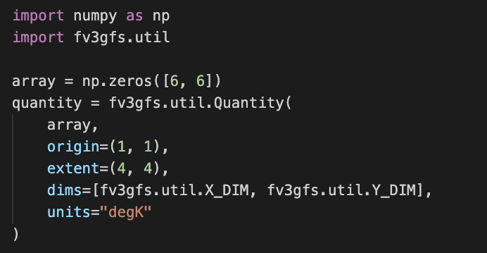
Quantity
Quantity Initialization
origin and extent are optional, but needed if you want halos
Notes:
29

Slide 30
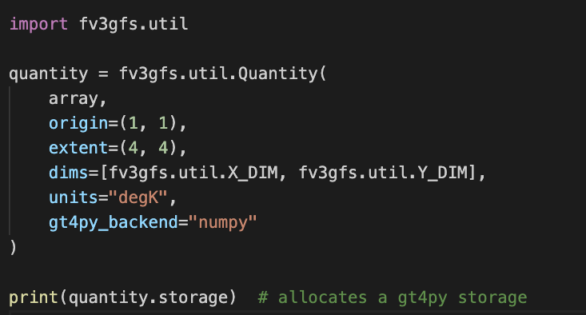
Quantity
GT4Py Integration
Can use this as a way to create gt4py storages
Notes:
30

Slide 31
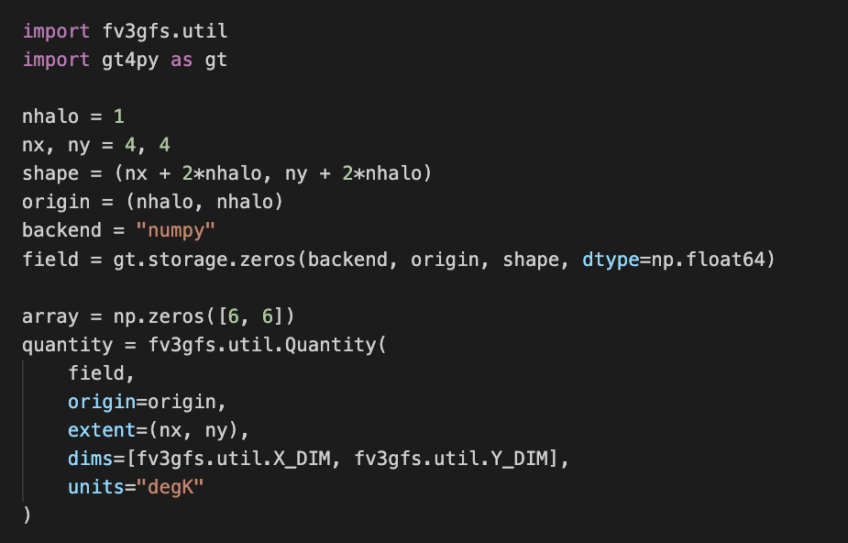
Quantity
GT4Py Integration
Can initialize from gt4py storages
Notes:
31

Slide 32
Notebook: Quantity
See you on Slack! Return in 10 minutes at 2:20 EST.
Notes:
32

Slide 33
Quantity
Quantity GPU Integration
If a GPU backend or storage is used:
quantity.data will be cupy array
quantity.np will be cupy, normally exists as numpy
Means e.g. quantity.np.mean(quantity.data) will work regardless of whether using cupy or numpy
Notes:
33

Slide 34
Halo Updates
Learning Goal:
Perform a halo update using a Quantity

Slide 35
Halo Updates
Review
Partitioner gives info needed to match ranks for halo updates
Quantity marks index positions of halos
We have all the information we need for a halo update!
Notes:
35

Slide 36
Halo Updates
CubedSphereCommunicator
Composed of a CubedSpherePartitioner and an MPI4py communicator
MPI4py comm
CubedSpherePartitioner
CubedSphereCommunicator
Notes:
36

Slide 37
Halo Updates
CubedSphereCommunicator
>>> import fv3gfs.util
>>> from mpi4py import MPI
>>> layout = (2, 2)
>>> partitioner = fv3gfs.util.CubedSpherePartitioner(
... fv3gfs.util.TilePartitioner(layout)
... ) >>> cube = fv3gfs.util.CubedSphereCommunicator(
... MPI.COMM_WORLD,
... partitioner
... )
MPI4py comm
CubedSpherePartitioner
CubedSphereCommunicator
Notes:
37

Slide 38
cube.halo_update(quantity, n_points=3)
Notes:
38

Slide 39
Hands-on Session
Now it’s your turn!
Session_3B_CubedSphereCommunicator.ipynb to work on
Run your own stencil on the cube!
Can return to “Moving Forward” sections in previous notebooks if you have time
See you on Slack! Next huddle at 4:15 pm EST.
Notes:
Solutions…
Next huddle at XXX am/pm EST.
39

